Slide 1
Technology Drivers
Geoff Huston
Chief Scientist
APNIC Labs

Slide 2
Some thoughts about Internet technology and its evolution

Slide 3
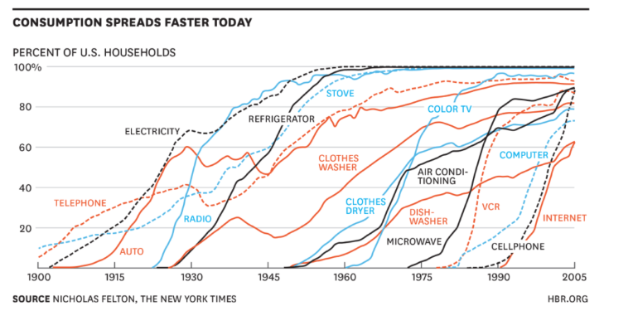
The Pace of Consumer Technology Adoption

Slide 4
The Pace of Consumer Technology Adoption
Household Electricity
50 years
Cellphones
20 years
Telephone
80 years
Internet
15 years

Slide 5
What Drives Technology Adoption?
Utility?
Consumer demand?
Provider push?
Marketing impetus?
Cost?
Revenue opportunities?
FOMO? (fear of missing out)

Slide 6
Examples of Technology-Driven Transformations
Circuits to Packets
  100x unit cost reduction in network service
  The change was large enough to destroy the existing telco market
Hardware to Cloudware
  2x – 4x unit cost reduction
  Moderate pace of change that has allowed some incumbents to ride the change while others have had a harder time
Domain Name Certificates
  From luxury good to free commodity resulting in market destruction
Fixed to Mobile
  Higher value perception allowed a price premium for mobile services

Slide 7
Some providers see advantage in adoption
Competitive positioning in a diverse market
Early adoption of future mainstream technologies (first mover advantage)
Perception of enhanced utility, security and safety in these more recent technologies

Slide 8
Sometimes it’s not so obvious
Why was IPv4 a runaway success while IPv6 has been a slow motion train wreck of prevarication and delay?
Why is security in the Internet a market failure?
Is Google now so entrenched that it is beyond all but the most disruptive of competitive technology pressures?

Slide 9
The saga of IPv6
IPv4 exhaustion was meant to propel IPv6 adoption
We were meant to have started and finished the transition before IPv4 ran out
We have been playing on the precipice of IPV4 exhaustion for the past 10 years, yet no IPV4 exhaustion and no universal IPv6
25 year transition with no end in sight
Why?
  No marginal unit cost improvement
  Incumbents feel no major pressure to adopt
  NATs vastly increase the address efficiency factor

Slide 10
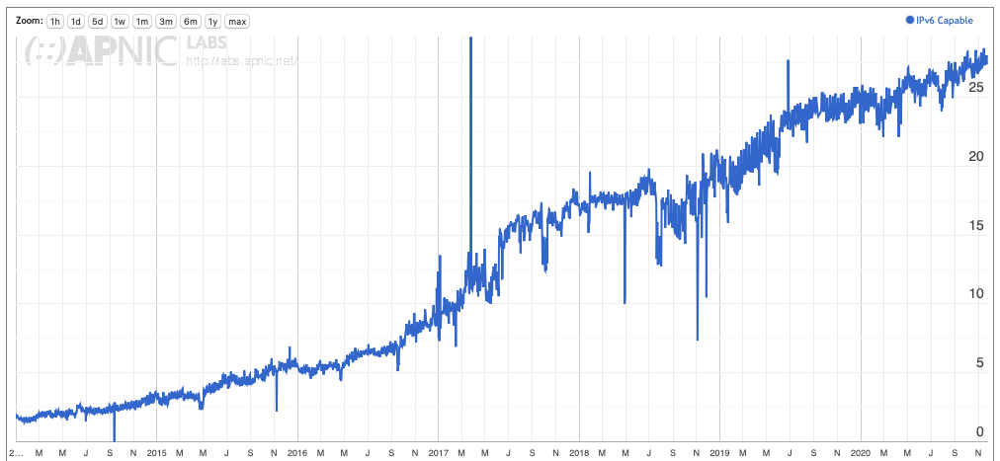
The saga of IPv6

Slide 11
Drivers
No clear early adopter advantage
No clear need
Client/server architectures don’t require a universal address model
NATs suppress demand through localisation and time multiplexing
IPv6 is a 1990’s technology solution to a 1980’s networking architectural challenge – today’s CDN feeder networks do not need globally unique address plans across every device all of the time

Slide 12
Another example of a stalled transition
DNSSEC
  Adding digital signature into the DNS to allow end users to be able to rely on the correctness of data provided in a DNS response
  Increased unit cost without clear incremental benefits
  Another protracted transition with no end in sight

Slide 13
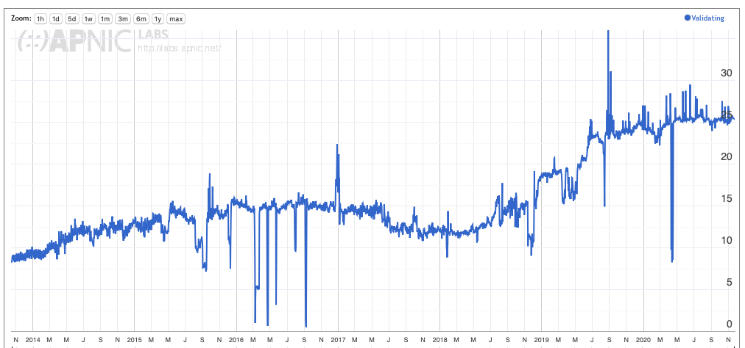
DNSSEC

Slide 14
Why?
Increased operational cost without clear incremental benefits
Not supported all the way to the edge of the network
Structural lies in the DNS are now what we expect/depend upon
  ”clean” DNS resolvers
  DNS64
No clear use case for a trusted DNS system
  Too slow to replace the Web PKI
  Does not get to the edge
  Too many intermediaries

Slide 15
Why do transitions fail?
No early adopter advantage
Incumbent resistance
Regulatory barriers
No consumer interest
No adoption momentum
Alternate use models

Slide 16
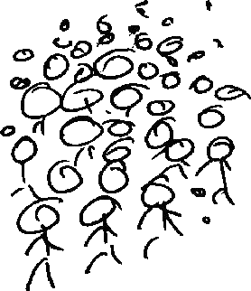

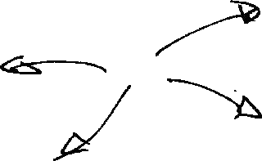
Challenges for Adoption
This is a deregulated and highly
competitive environment
There are many different players
Each with their own perspective
?
And all potential approaches will be explored!

Slide 17
Challenges for Adoption
2. The myth of long-term planning
?
“IPv6 Transition will take many years...
5 years, maybe 10 years, maybe longer”
Are we still firmly committed to the plans we had 5 years ago? How about our 10-year-old plans?
The longer the period of transition, the higher the risk of completely losing the plot and heading into other directions!

Slide 18
Today’s Internet Architecture
Challenges for Adoption
The Internet keeps changing

Slide 19
What drives change?
The Internet is a market, like any other
  Consumers of Internet goods and services make purchasing choices
  These consumer choices are what drives the market
Consumers tend to show cost-based preferences
  Innovation that reduces the cost base of services tend to gain market share
The greater the cost shift the greater the impact of the innovation on the providers
  There is often a “tipping point” of innovative change that makes it irresistible

Slide 20
Economics of Innovation
Adoption pressure
Incumbent Resistance
Incumbent Replacement
Market Destruction!
2x
4x
16x
32x
64x
Unit Cost Reduction

Slide 21
What resists change?
Volume tends to increase inertial resistance
  And the digital world has massive volume
Monopoly incumbency resists change
  And the digital world is now dominated by a small set of incumbents
Changes that do not impact the cost base of the service increases resistance
The emergence of large scale digital incumbents creates its own challenges

Slide 22
Economics of Innovation
“incumbent
entrenchment”
level
open
markets
monopolies
Adoption pressure
Incumbent Resistance
Incumbent Replacement
Market Destruction!
2x
4x
16x
32x
64x
Unit Cost Reduction

Slide 23
Telco lessons
The entrenched incumbency of the telco regime created an “innovation debt”
  Most of the ideas behind the internet were explored in the 1960’s
  But the integration of data services was resisted by the telcos as they suspected it would undermine the margins of the voice business
  The longer this blockage remained the greater the pressure to break through
The eventual breakthrough put the entirety of the telco revenues up for grab
  And this is at the heart of the disruption in this sector

Slide 24
And today?
We seem to be repeating this cycle
The large scale incumbents are bedding down and stabilising their business model, and suppressing further unmanaged innovation pressures
The longer this situation lasts the greater the level of disruption when it all falls apart!

Slide 25
Progress, far from consisting in change, depends on retentiveness. When change is absolute there remains no being to improve and no direction is set for possible improvement: and when experience is not retained, as among savages, infancy is perpetual. Those who cannot remember the past are condemned to repeat it.
George Satayana, The Life of Reason, 1905-1906

Slide 26
Thanks!

